Slide 1


Slide 2
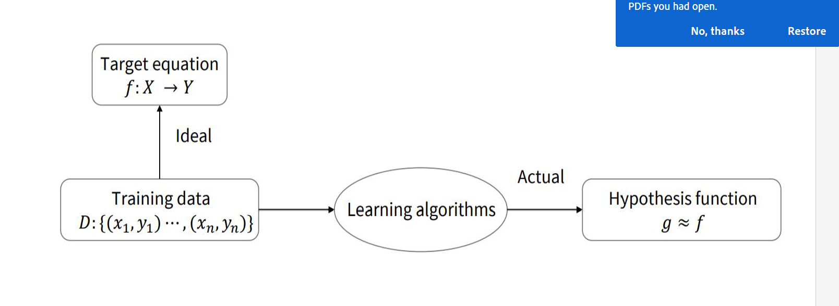

Slide 3
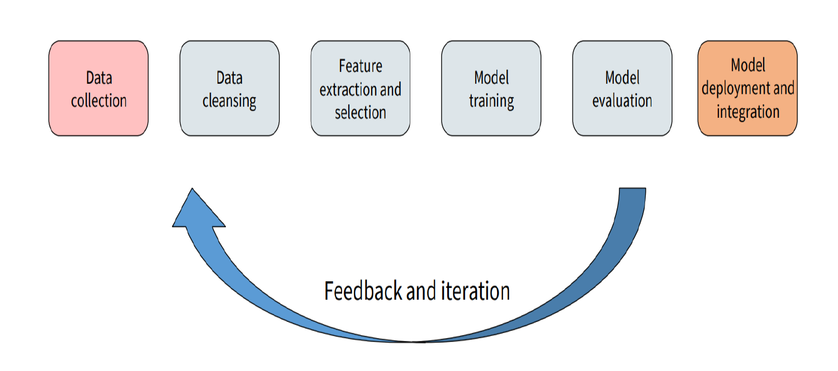

Slide 4
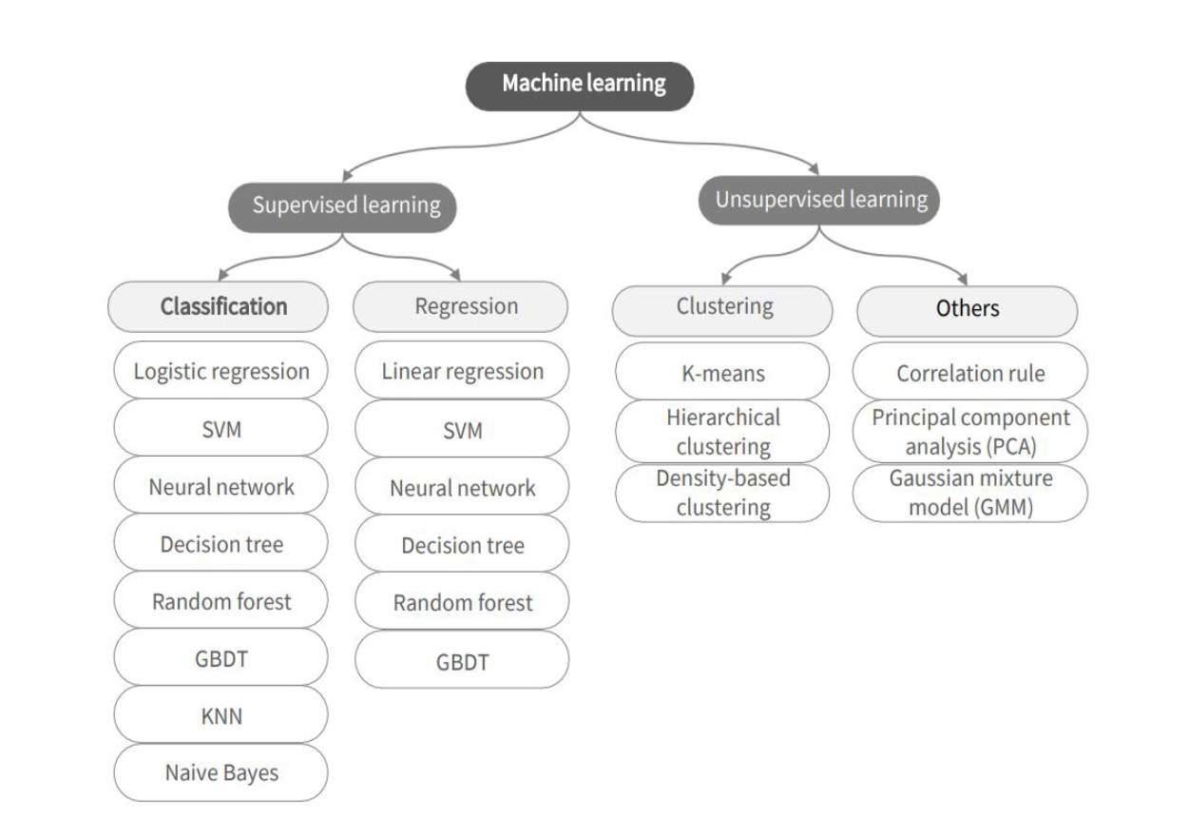

Slide 5
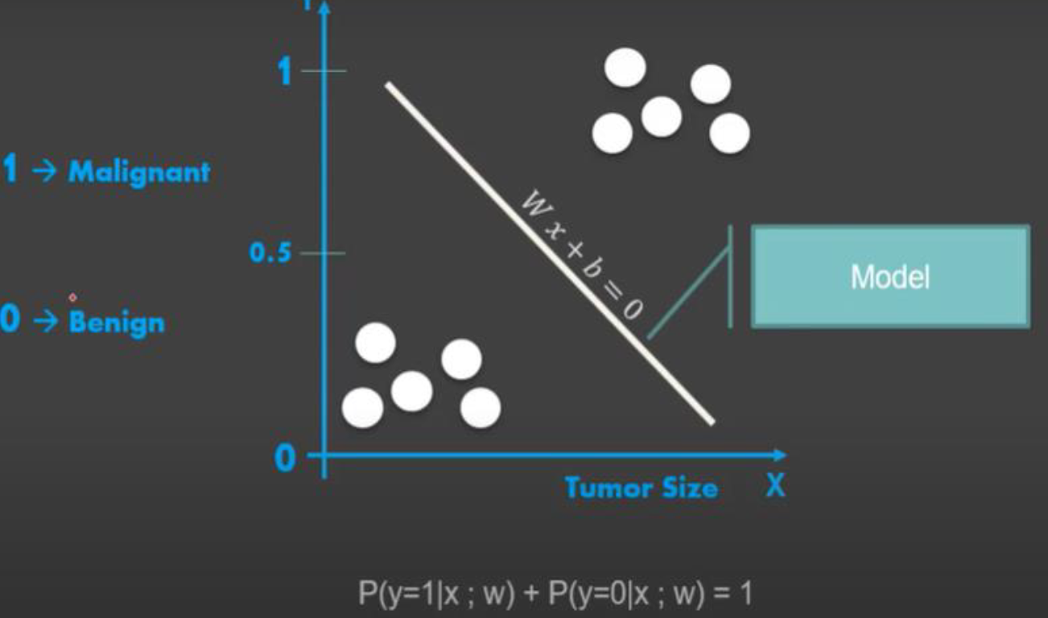

Slide 6
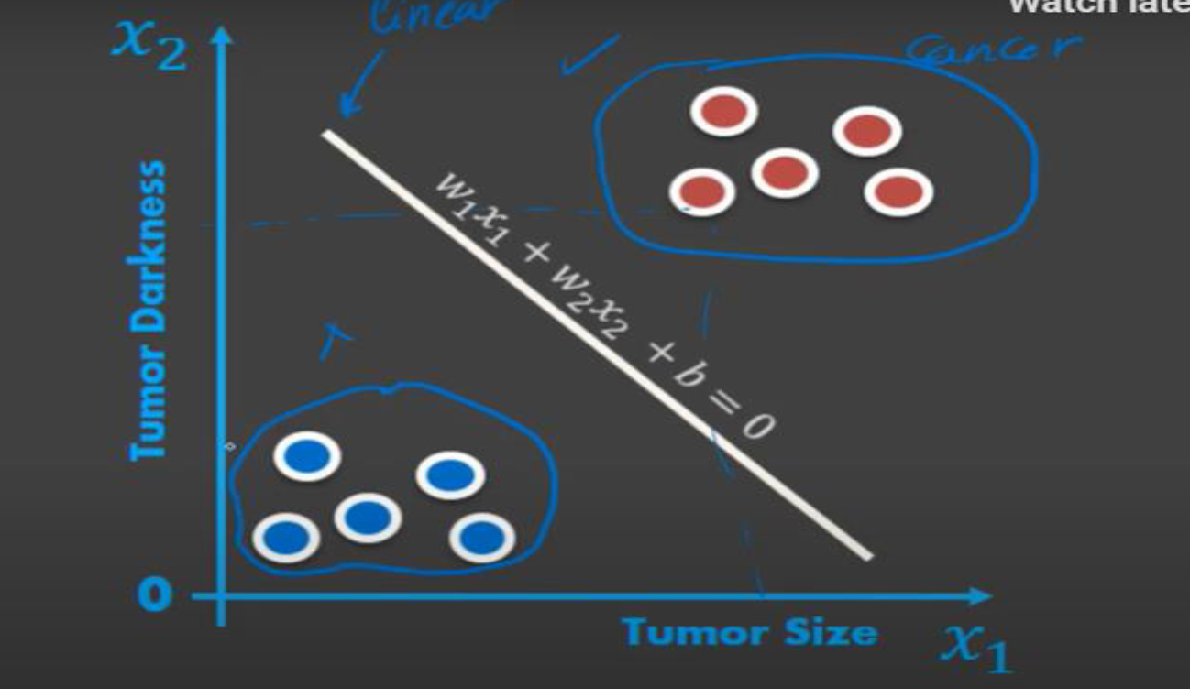

Slide 7
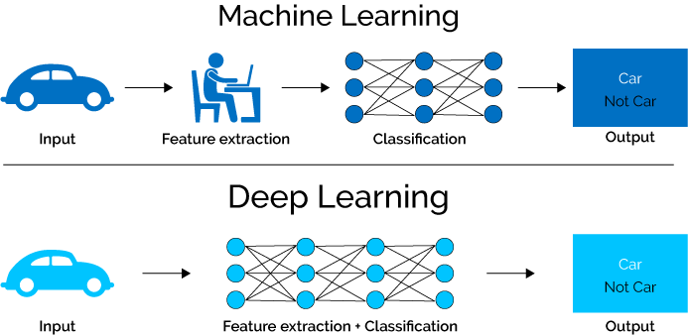
ML vs. Deep Learning
Deep learning (DL) is a machine learning subfield that uses multiple layers for learning data representations
DL is exceptionally effective at learning patterns
Time consuming/feature dimensions

Slide 8
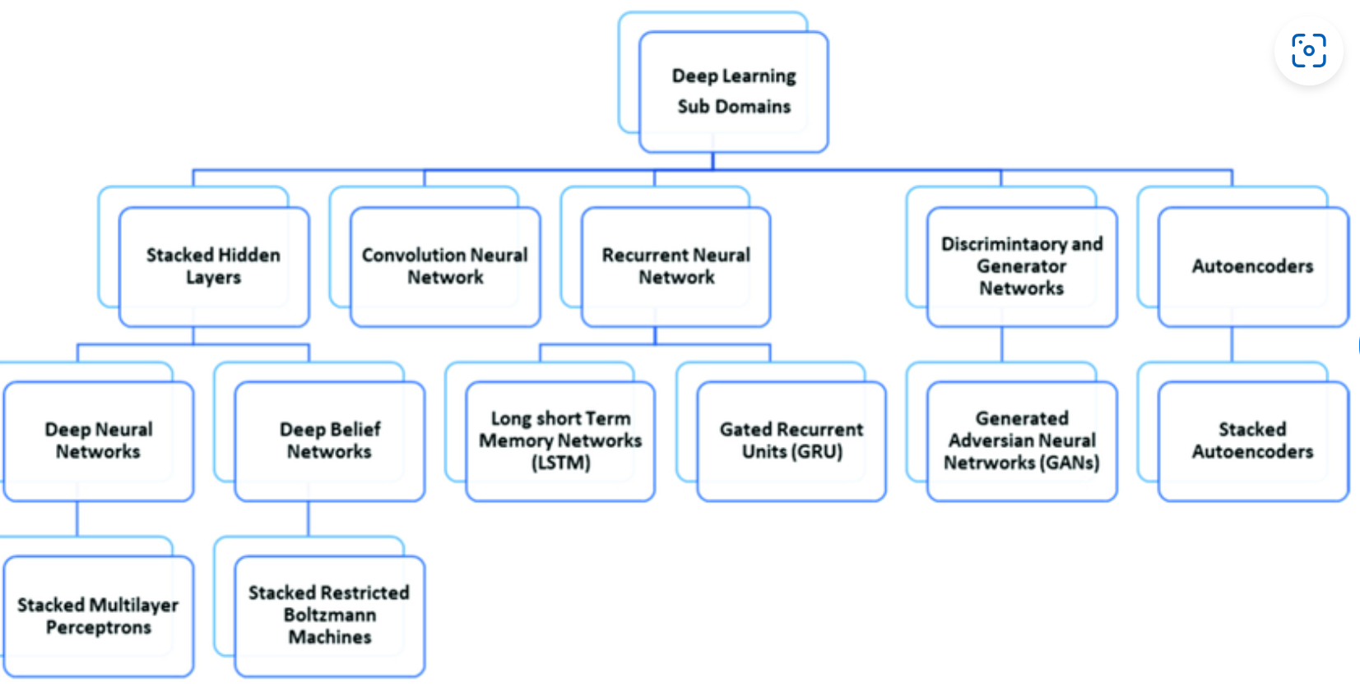

Slide 9
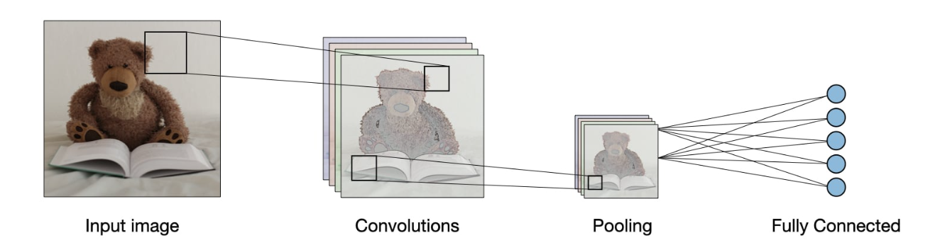

Slide 10
First, let’s discuss briefly Image filtering

Slide 11
Image filtering
Image filtering: compute function of local neighborhood at each position
Really important!
Enhance images
Denoise, resize, increase contrast, etc.
Extract information from images
Texture, edges, distinctive points, etc.
Detect patterns
Template matching
Deep Convolutional Networks

Slide 12

Example: box filter
1
1
1
1
1
1
1
1
1
Slide credit: David Lowe (UBC)

Slide 13
Image filtering
1
1
1
1
1
1
1
1
1
0 | 0 | 0 | 0 | 0 | 0 | 0 | 0 | 0 | 0
0 | 0 | 0 | 0 | 0 | 0 | 0 | 0 | 0 | 0
0 | 0 | 0 | 90 | 90 | 90 | 90 | 90 | 0 | 0
0 | 0 | 0 | 90 | 90 | 90 | 90 | 90 | 0 | 0
0 | 0 | 0 | 90 | 90 | 90 | 90 | 90 | 0 | 0
0 | 0 | 0 | 90 | 0 | 90 | 90 | 90 | 0 | 0
0 | 0 | 0 | 90 | 90 | 90 | 90 | 90 | 0 | 0
0 | 0 | 0 | 0 | 0 | 0 | 0 | 0 | 0 | 0
0 | 0 | 90 | 0 | 0 | 0 | 0 | 0 | 0 | 0
0 | 0 | 0 | 0 | 0 | 0 | 0 | 0 | 0 | 0
 | 0
0 | 0 | 0 | 0 | 0 | 0 | 0 | 0 | 0 | 0
0 | 0 | 0 | 0 | 0 | 0 | 0 | 0 | 0 | 0
0 | 0 | 0 | 90 | 90 | 90 | 90 | 90 | 0 | 0
0 | 0 | 0 | 90 | 90 | 90 | 90 | 90 | 0 | 0
0 | 0 | 0 | 90 | 90 | 90 | 90 | 90 | 0 | 0
0 | 0 | 0 | 90 | 0 | 90 | 90 | 90 | 0 | 0
0 | 0 | 0 | 90 | 90 | 90 | 90 | 90 | 0 | 0
0 | 0 | 0 | 0 | 0 | 0 | 0 | 0 | 0 | 0
0 | 0 | 90 | 0 | 0 | 0 | 0 | 0 | 0 | 0
0 | 0 | 0 | 0 | 0 | 0 | 0 | 0 | 0 | 0
Credit: S. Seitz
Notes:
ones, divide by 9

Slide 14
Image filtering
1
1
1
1
1
1
1
1
1
0 | 0 | 0 | 0 | 0 | 0 | 0 | 0 | 0 | 0
0 | 0 | 0 | 0 | 0 | 0 | 0 | 0 | 0 | 0
0 | 0 | 0 | 90 | 90 | 90 | 90 | 90 | 0 | 0
0 | 0 | 0 | 90 | 90 | 90 | 90 | 90 | 0 | 0
0 | 0 | 0 | 90 | 90 | 90 | 90 | 90 | 0 | 0
0 | 0 | 0 | 90 | 0 | 90 | 90 | 90 | 0 | 0
0 | 0 | 0 | 90 | 90 | 90 | 90 | 90 | 0 | 0
0 | 0 | 0 | 0 | 0 | 0 | 0 | 0 | 0 | 0
0 | 0 | 90 | 0 | 0 | 0 | 0 | 0 | 0 | 0
0 | 0 | 0 | 0 | 0 | 0 | 0 | 0 | 0 | 0
 | 0 | 10
0 | 0 | 0 | 0 | 0 | 0 | 0 | 0 | 0 | 0
0 | 0 | 0 | 0 | 0 | 0 | 0 | 0 | 0 | 0
0 | 0 | 0 | 90 | 90 | 90 | 90 | 90 | 0 | 0
0 | 0 | 0 | 90 | 90 | 90 | 90 | 90 | 0 | 0
0 | 0 | 0 | 90 | 90 | 90 | 90 | 90 | 0 | 0
0 | 0 | 0 | 90 | 0 | 90 | 90 | 90 | 0 | 0
0 | 0 | 0 | 90 | 90 | 90 | 90 | 90 | 0 | 0
0 | 0 | 0 | 0 | 0 | 0 | 0 | 0 | 0 | 0
0 | 0 | 90 | 0 | 0 | 0 | 0 | 0 | 0 | 0
0 | 0 | 0 | 0 | 0 | 0 | 0 | 0 | 0 | 0
Credit: S. Seitz
Notes:
ones, divide by 9

Slide 15
Image filtering
1
1
1
1
1
1
1
1
1
0 | 0 | 0 | 0 | 0 | 0 | 0 | 0 | 0 | 0
0 | 0 | 0 | 0 | 0 | 0 | 0 | 0 | 0 | 0
0 | 0 | 0 | 90 | 90 | 90 | 90 | 90 | 0 | 0
0 | 0 | 0 | 90 | 90 | 90 | 90 | 90 | 0 | 0
0 | 0 | 0 | 90 | 90 | 90 | 90 | 90 | 0 | 0
0 | 0 | 0 | 90 | 0 | 90 | 90 | 90 | 0 | 0
0 | 0 | 0 | 90 | 90 | 90 | 90 | 90 | 0 | 0
0 | 0 | 0 | 0 | 0 | 0 | 0 | 0 | 0 | 0
0 | 0 | 90 | 0 | 0 | 0 | 0 | 0 | 0 | 0
0 | 0 | 0 | 0 | 0 | 0 | 0 | 0 | 0 | 0
 | 0 | 10 | 20
0 | 0 | 0 | 0 | 0 | 0 | 0 | 0 | 0 | 0
0 | 0 | 0 | 0 | 0 | 0 | 0 | 0 | 0 | 0
0 | 0 | 0 | 90 | 90 | 90 | 90 | 90 | 0 | 0
0 | 0 | 0 | 90 | 90 | 90 | 90 | 90 | 0 | 0
0 | 0 | 0 | 90 | 90 | 90 | 90 | 90 | 0 | 0
0 | 0 | 0 | 90 | 0 | 90 | 90 | 90 | 0 | 0
0 | 0 | 0 | 90 | 90 | 90 | 90 | 90 | 0 | 0
0 | 0 | 0 | 0 | 0 | 0 | 0 | 0 | 0 | 0
0 | 0 | 90 | 0 | 0 | 0 | 0 | 0 | 0 | 0
0 | 0 | 0 | 0 | 0 | 0 | 0 | 0 | 0 | 0
Credit: S. Seitz
Notes:
ones, divide by 9

Slide 16
Image filtering
1
1
1
1
1
1
1
1
1
0 | 0 | 0 | 0 | 0 | 0 | 0 | 0 | 0 | 0
0 | 0 | 0 | 0 | 0 | 0 | 0 | 0 | 0 | 0
0 | 0 | 0 | 90 | 90 | 90 | 90 | 90 | 0 | 0
0 | 0 | 0 | 90 | 90 | 90 | 90 | 90 | 0 | 0
0 | 0 | 0 | 90 | 90 | 90 | 90 | 90 | 0 | 0
0 | 0 | 0 | 90 | 0 | 90 | 90 | 90 | 0 | 0
0 | 0 | 0 | 90 | 90 | 90 | 90 | 90 | 0 | 0
0 | 0 | 0 | 0 | 0 | 0 | 0 | 0 | 0 | 0
0 | 0 | 90 | 0 | 0 | 0 | 0 | 0 | 0 | 0
0 | 0 | 0 | 0 | 0 | 0 | 0 | 0 | 0 | 0
 | 0 | 10 | 20 | 30
0 | 0 | 0 | 0 | 0 | 0 | 0 | 0 | 0 | 0
0 | 0 | 0 | 0 | 0 | 0 | 0 | 0 | 0 | 0
0 | 0 | 0 | 90 | 90 | 90 | 90 | 90 | 0 | 0
0 | 0 | 0 | 90 | 90 | 90 | 90 | 90 | 0 | 0
0 | 0 | 0 | 90 | 90 | 90 | 90 | 90 | 0 | 0
0 | 0 | 0 | 90 | 0 | 90 | 90 | 90 | 0 | 0
0 | 0 | 0 | 90 | 90 | 90 | 90 | 90 | 0 | 0
0 | 0 | 0 | 0 | 0 | 0 | 0 | 0 | 0 | 0
0 | 0 | 90 | 0 | 0 | 0 | 0 | 0 | 0 | 0
0 | 0 | 0 | 0 | 0 | 0 | 0 | 0 | 0 | 0
Credit: S. Seitz
Notes:
ones, divide by 9

Slide 17
Image filtering
1
1
1
1
1
1
1
1
1
0 | 0 | 0 | 0 | 0 | 0 | 0 | 0 | 0 | 0
0 | 0 | 0 | 0 | 0 | 0 | 0 | 0 | 0 | 0
0 | 0 | 0 | 90 | 90 | 90 | 90 | 90 | 0 | 0
0 | 0 | 0 | 90 | 90 | 90 | 90 | 90 | 0 | 0
0 | 0 | 0 | 90 | 90 | 90 | 90 | 90 | 0 | 0
0 | 0 | 0 | 90 | 0 | 90 | 90 | 90 | 0 | 0
0 | 0 | 0 | 90 | 90 | 90 | 90 | 90 | 0 | 0
0 | 0 | 0 | 0 | 0 | 0 | 0 | 0 | 0 | 0
0 | 0 | 90 | 0 | 0 | 0 | 0 | 0 | 0 | 0
0 | 0 | 0 | 0 | 0 | 0 | 0 | 0 | 0 | 0
 | 0 | 10 | 20 | 30 | 30
Credit: S. Seitz
Notes:
ones, divide by 9

Slide 18
Image filtering
1
1
1
1
1
1
1
1
1
0 | 0 | 0 | 0 | 0 | 0 | 0 | 0 | 0 | 0
0 | 0 | 0 | 0 | 0 | 0 | 0 | 0 | 0 | 0
0 | 0 | 0 | 90 | 90 | 90 | 90 | 90 | 0 | 0
0 | 0 | 0 | 90 | 90 | 90 | 90 | 90 | 0 | 0
0 | 0 | 0 | 90 | 90 | 90 | 90 | 90 | 0 | 0
0 | 0 | 0 | 90 | 0 | 90 | 90 | 90 | 0 | 0
0 | 0 | 0 | 90 | 90 | 90 | 90 | 90 | 0 | 0
0 | 0 | 0 | 0 | 0 | 0 | 0 | 0 | 0 | 0
0 | 0 | 90 | 0 | 0 | 0 | 0 | 0 | 0 | 0
0 | 0 | 0 | 0 | 0 | 0 | 0 | 0 | 0 | 0
 | 0 | 10 | 20 | 30 | 30
?
Credit: S. Seitz
Notes:
ones, divide by 9

Slide 19
Image filtering
1
1
1
1
1
1
1
1
1
0 | 0 | 0 | 0 | 0 | 0 | 0 | 0 | 0 | 0
0 | 0 | 0 | 0 | 0 | 0 | 0 | 0 | 0 | 0
0 | 0 | 0 | 90 | 90 | 90 | 90 | 90 | 0 | 0
0 | 0 | 0 | 90 | 90 | 90 | 90 | 90 | 0 | 0
0 | 0 | 0 | 90 | 90 | 90 | 90 | 90 | 0 | 0
0 | 0 | 0 | 90 | 0 | 90 | 90 | 90 | 0 | 0
0 | 0 | 0 | 90 | 90 | 90 | 90 | 90 | 0 | 0
0 | 0 | 0 | 0 | 0 | 0 | 0 | 0 | 0 | 0
0 | 0 | 90 | 0 | 0 | 0 | 0 | 0 | 0 | 0
0 | 0 | 0 | 0 | 0 | 0 | 0 | 0 | 0 | 0
 | 0 | 10 | 20 | 30 | 30
 |  |  |  | 50
?
Credit: S. Seitz
Notes:
ones, divide by 9

Slide 20
Image filtering
1
1
1
1
1
1
1
1
1
0 | 0 | 0 | 0 | 0 | 0 | 0 | 0 | 0 | 0
0 | 0 | 0 | 0 | 0 | 0 | 0 | 0 | 0 | 0
0 | 0 | 0 | 90 | 90 | 90 | 90 | 90 | 0 | 0
0 | 0 | 0 | 90 | 90 | 90 | 90 | 90 | 0 | 0
0 | 0 | 0 | 90 | 90 | 90 | 90 | 90 | 0 | 0
0 | 0 | 0 | 90 | 0 | 90 | 90 | 90 | 0 | 0
0 | 0 | 0 | 90 | 90 | 90 | 90 | 90 | 0 | 0
0 | 0 | 0 | 0 | 0 | 0 | 0 | 0 | 0 | 0
0 | 0 | 90 | 0 | 0 | 0 | 0 | 0 | 0 | 0
0 | 0 | 0 | 0 | 0 | 0 | 0 | 0 | 0 | 0
 | 0 | 10 | 20 | 30 | 30 | 30 | 20 | 10
 | 0 | 20 | 40 | 60 | 60 | 60 | 40 | 20
 | 0 | 30 | 60 | 90 | 90 | 90 | 60 | 30
 | 0 | 30 | 50 | 80 | 80 | 90 | 60 | 30
 | 0 | 30 | 50 | 80 | 80 | 90 | 60 | 30
 | 0 | 20 | 30 | 50 | 50 | 60 | 40 | 20
 | 10 | 20 | 30 | 30 | 30 | 30 | 20 | 10
 | 10 | 10 | 10 | 0 | 0 | 0 | 0 | 0
Credit: S. Seitz

Slide 21
Box Filter
What does it do?
Replaces each pixel with an average of its neighborhood
Achieve smoothing effect (remove sharp features)
1
1
1
1
1
1
1
1
1
Slide credit: David Lowe (UBC)

Slide 22
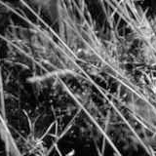
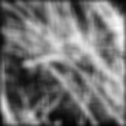
Smoothing with box filter

Slide 23
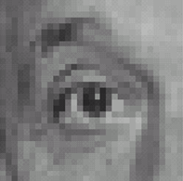
Practice with linear filters
0
0
0
?
0
1
0
0
0
0
Original
Source: D. Lowe

Slide 24
Practice with linear filters
0
0
0
0
1
0
0
0
0
Original
Filtered
(no change)
Source: D. Lowe

Slide 25
Practice with linear filters
0
0
0
?
0
0
1
0
0
0
Original
Source: D. Lowe

Slide 26
Practice with linear filters
0
0
0
0
0
1
0
0
0
Original
Shifted left
By 1 pixel
Source: D. Lowe

Slide 27

Practice with linear filters
0
0
0
-
1
1
1
?
0
2
0
1
1
1
0
0
0
1
1
1
(Note that filter sums to 1)
Original
Source: D. Lowe

Slide 28
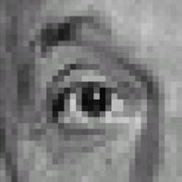
Practice with linear filters
0
0
0
-
1
1
1
0
2
0
1
1
1
0
0
0
1
1
1
Original
Sharpening filter
Accentuates differences with local average
Source: D. Lowe

Slide 29
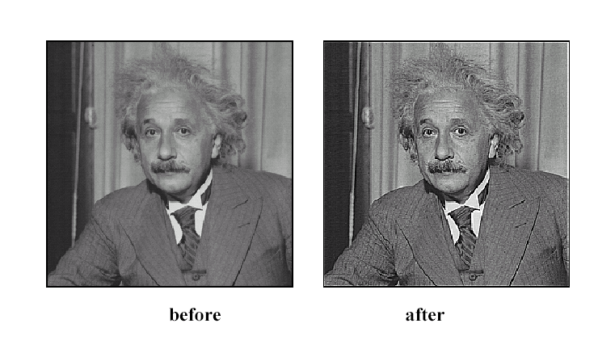
Sharpening
Source: D. Lowe

Slide 30
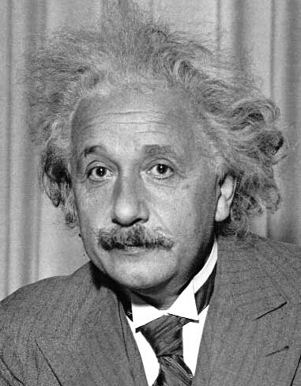
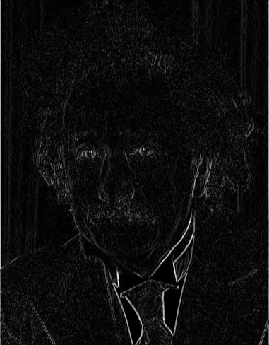
Other filters
1
0
-1
2
0
-2
1
0
-1
Sobel
Vertical Edge
(absolute value)

Slide 31
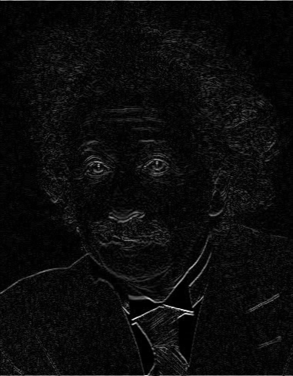
Other filters
1
2
1
0
0
0
-1
-2
-1
Sobel
Horizontal Edge
(absolute value)
Notes:
Questions at this point?

